Slide 1
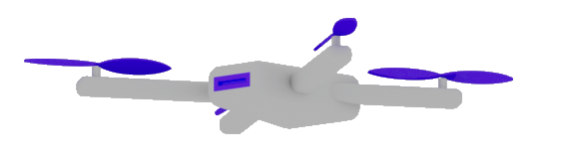

AI-Beyond Basics
Dr. Damir Dobric
Lead Software Architect daenet GmbH / ACP Digital
Microsoft Regional Director,
Most Valuable Professional: AI

Slide 2

ML vs. GenAI What is different and why it is important?
Traditional ML
Lot of Data
Long Training
GenAI
Pretrained
GPT=General Pretrained Transformer

Slide 3
AI Services
Open AI
https://platform.openai.com/docs/models
Azure AI Foundry https://oai.azure.com/portal/****/models https://ai.azure.com/
Request Access to Azure OpenAI Service (microsoft.com)

Slide 4
TOKENS

Slide 5

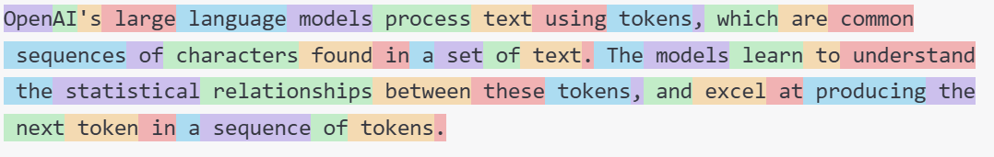
What are Tokens?
1 token ~= 4 chars in English
1 token ~= ¾ words
100 tokens ~= 75 words
Byte Pare Encoding (Gage,1994): Wikipedia
What are tokens and how to count them?
Token Pricing: Pricing (openai.com)

Slide 6
DEMO
Tokenizer
Creating tokens in C#

Slide 7
EMBEDDINGS

Slide 8
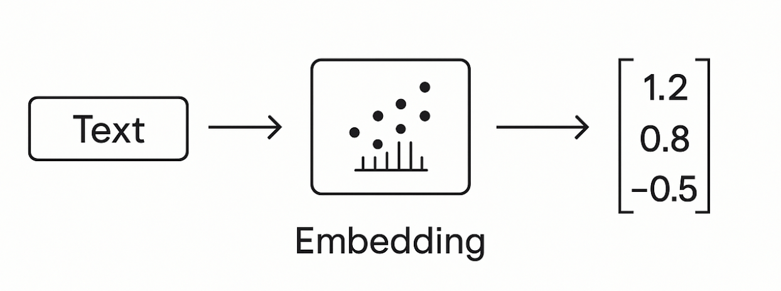
Embeddings
Making a vector from text

Slide 9
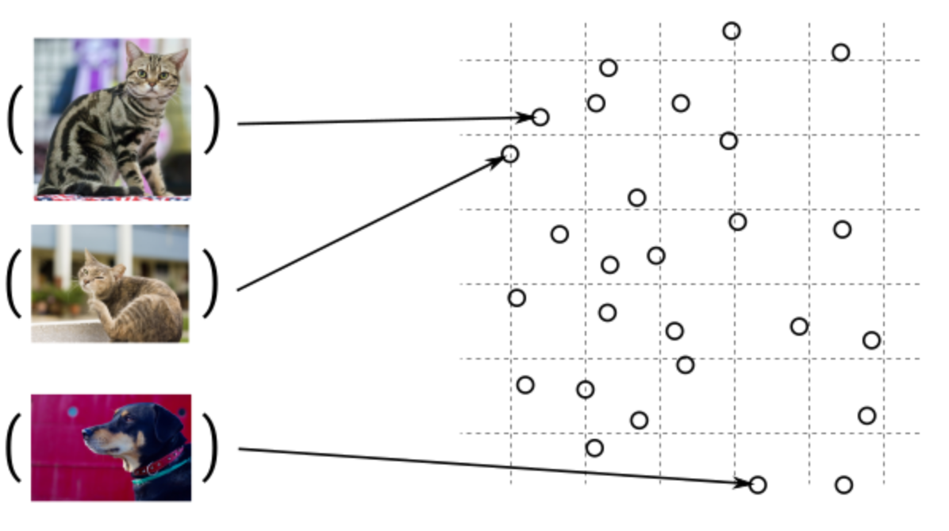
Guess, today is a nice day in Palma
Embedding Models
Today is a typical German rainy day
Two things are infinite: the universe and human stupidity; and I'm not sure about the universe.

Slide 10

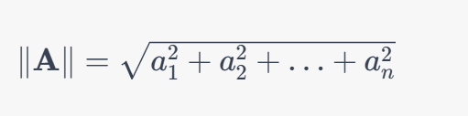
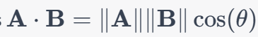
Similarity Between Multidimensional Vectors
Dot Product
The Norm
Cosine Similarity

Slide 11
When to use Embeddings?
Semantic Search
Classification
Clustering
Recommendations
. . .

Slide 12
DEMO
Consuming Embedding Model with HTTP/Post
Creating Embeddings in C#

Slide 13
VECTOR DATABASES

Slide 14
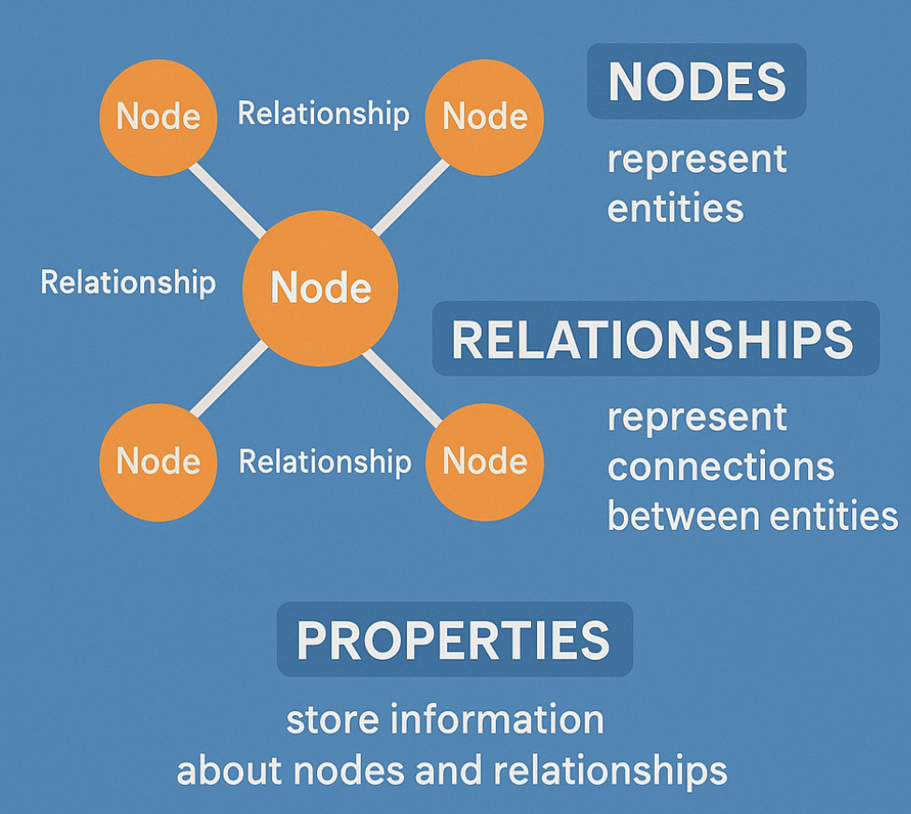
Graph Databases

Slide 15
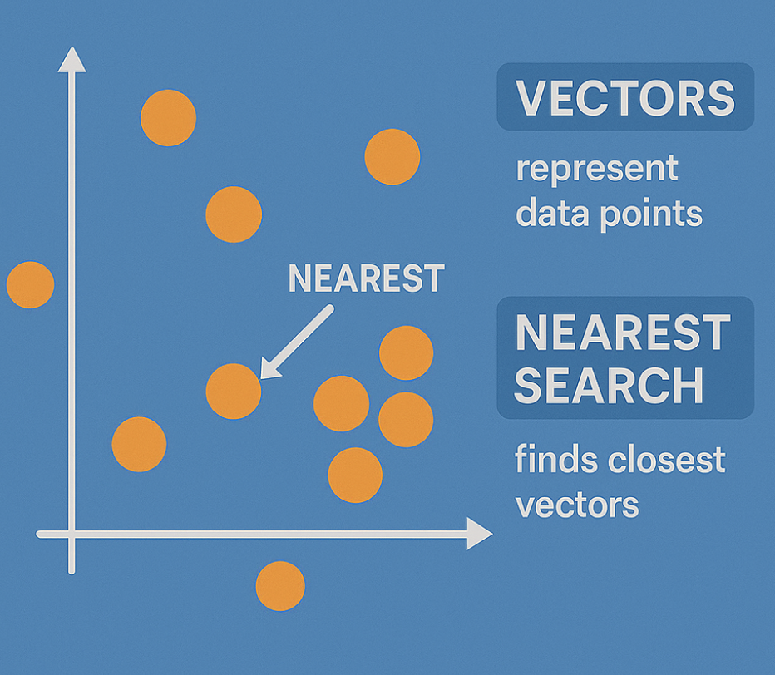
Embeddings in GraphDB

Slide 16
Vector DBs
SqlServer 2025 Native Vector Search
Quadrant
CosmosDB
…

Slide 17
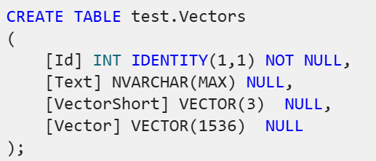
SqlServer 2025 Native Vector Search
SqlServer 2025 Native Vector Search
In Azure
On-Prem
SQL Server Native Vector Search for .NET Developers

Slide 18

The New Vector Type
sqlCmd.Parameters.AddWithValue("@Vector", JsonSerializer.Serialize(new float[] { 1.12f, 2.22f, 3.33f }));
sqlCmd.Parameters.AddWithValue("@Vector", ‘[1.12, 2.22, 3.33]’);

Slide 19
DEMO
SQL Server Native Vector Search
SQL Server Native Vector
DECLARE @v1 VECTOR(2) = '[1,1]';
DECLARE @v2 VECTOR(2) = '[-1,-1]';
SELECT
VECTOR_DISTANCE('euclidean', @v1, @v2) AS euclidean,
VECTOR_DISTANCE('cosine', @v1, @v2) AS cosine,
VECTOR_DISTANCE('dot', @v1, @v2) AS negative_dot_product;

Slide 20
COMPLETION MODELS
How does all this work?

Slide 21
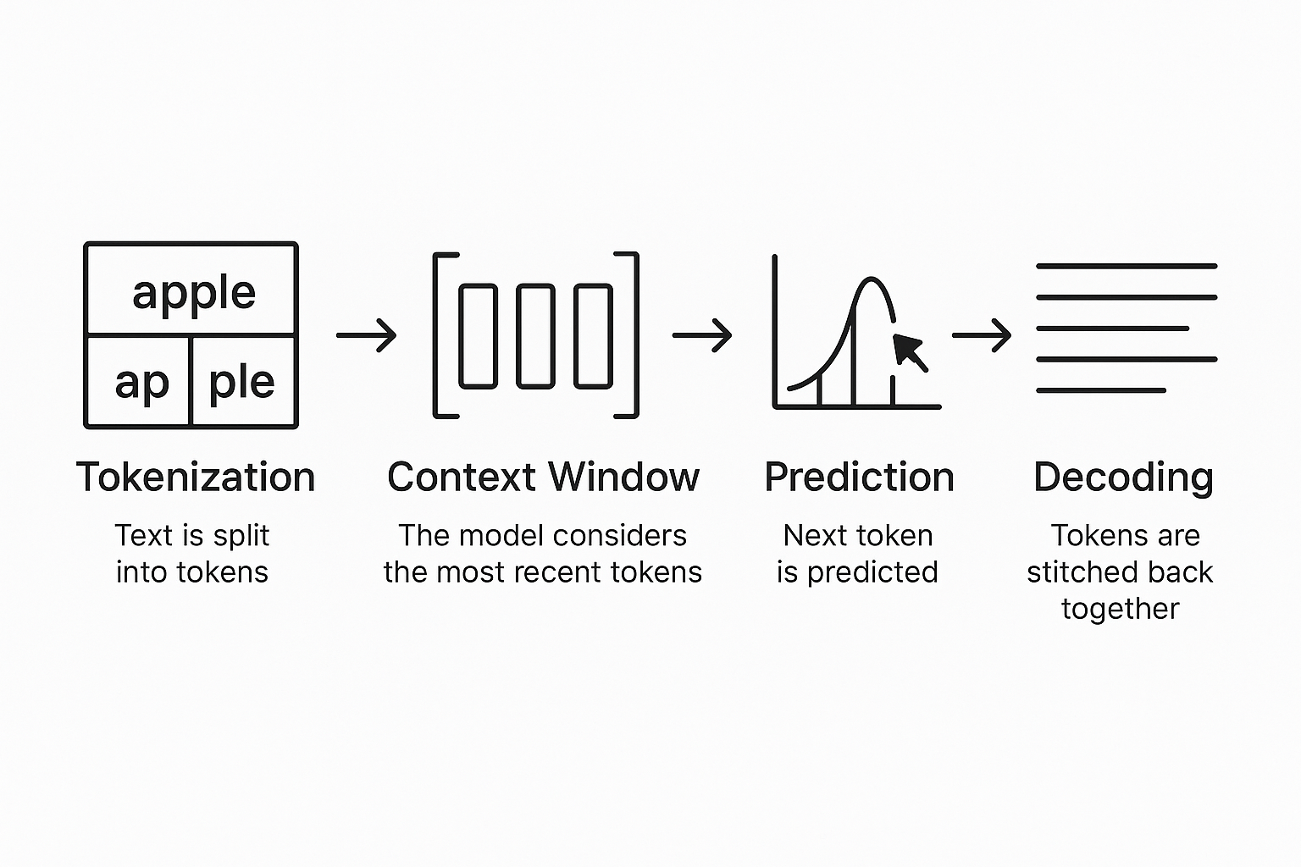
Completion Models
Text Completion Flow

Slide 22
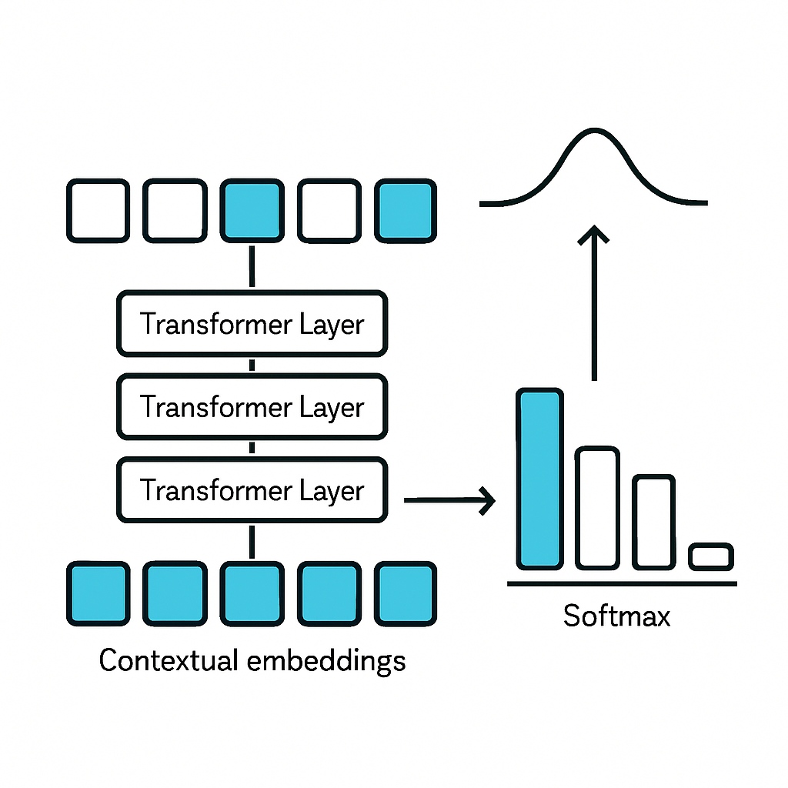
The algorithm
Transformers

Slide 23

DEMO
C# Application
Using OpenAI nuget package
Executing ChatCompletions
Presenting Probabilities

Slide 24
A Scientific look under the hub

Slide 25
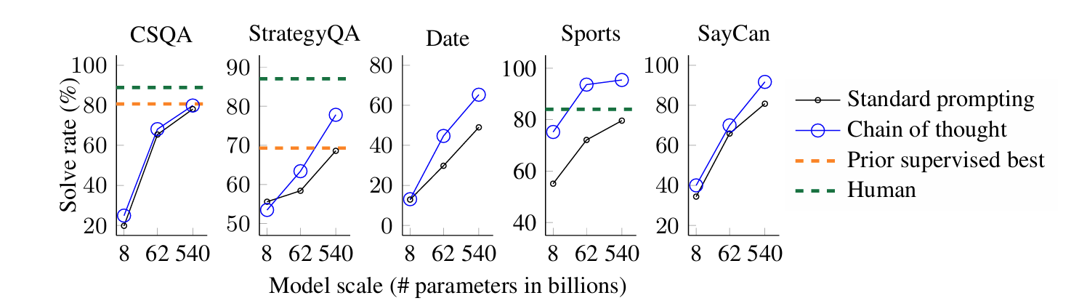
Chain of Tought
A prompting technique used to improve reasoning
Models think step by step before giving an answer.
Google Research, Brain Team
https://arxiv.org/abs/2201.11903

Slide 26
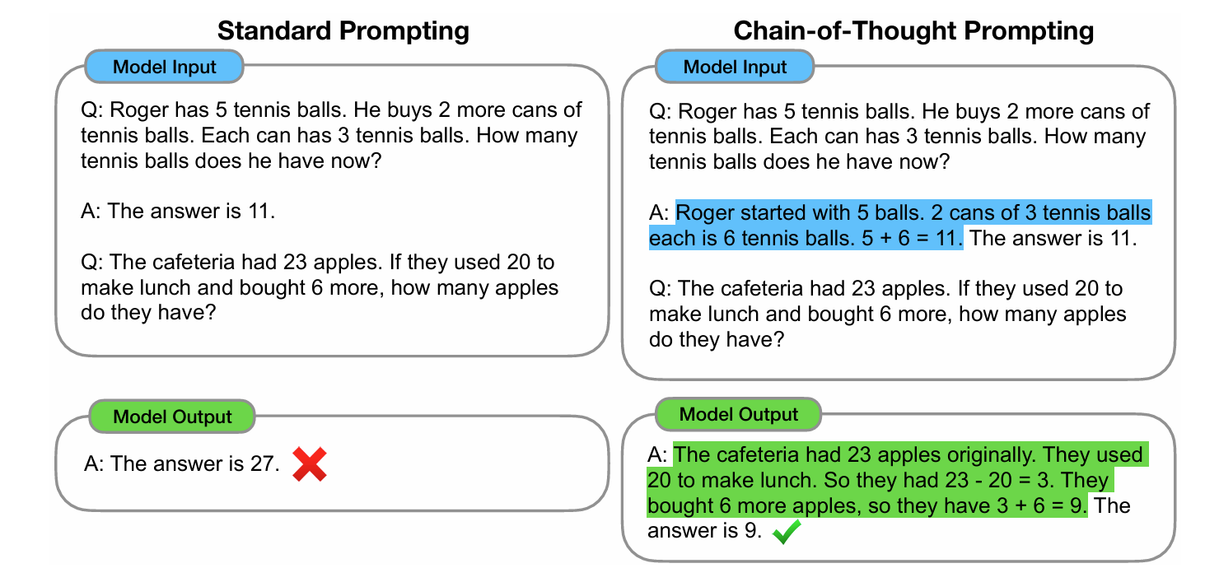
The Chain of Tought (CoT)

Slide 27
Reasoning
Common Models are
Outcome-Supervised Reward Models (ORM).
They use final answers
Reasoning Models
Receive Feedback on Each Step in Chain-of-Tought process
Process Reasoning Models (PRM)
https://cdn.openai.com/improving-mathematical-reasoning-with-process-supervision/Lets_Verify_Step_by_Step.pdf

Slide 28
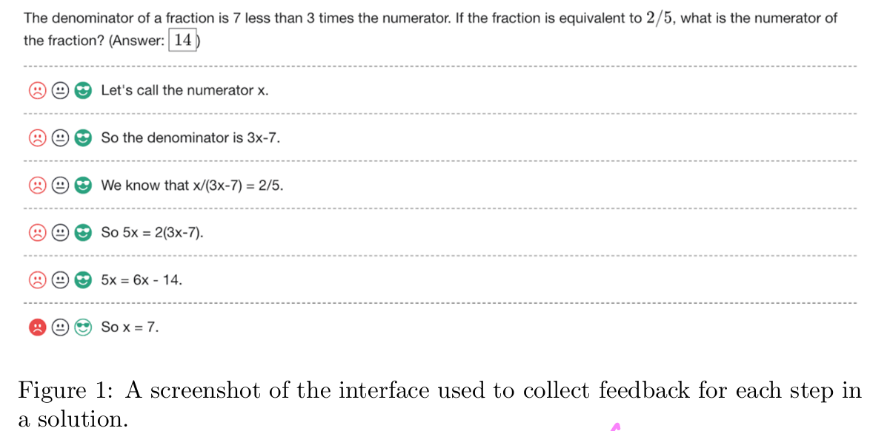
Human Supervised Learning

Slide 29
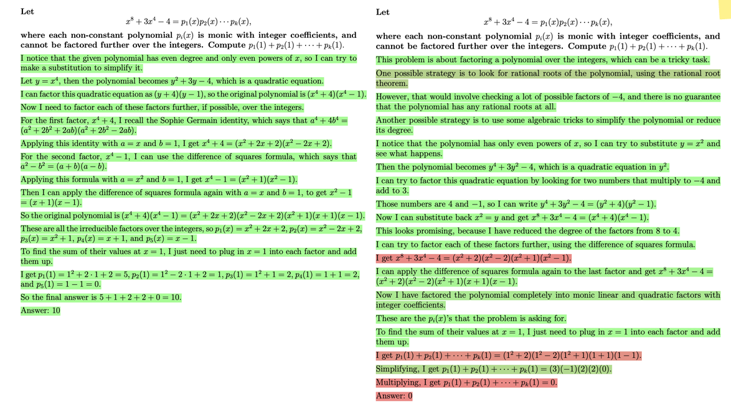

Slide 30
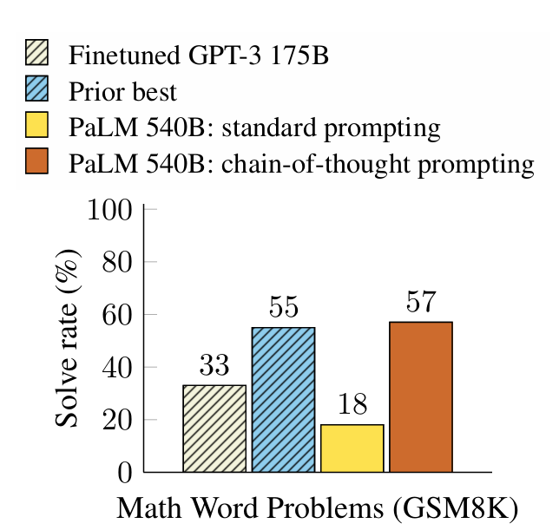
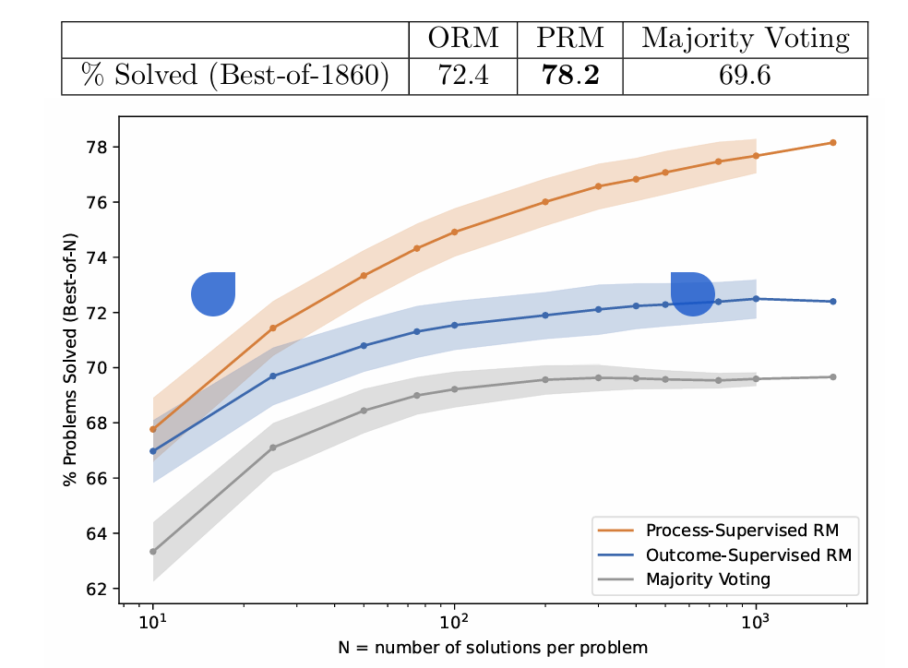
Comparison: CoT vs. PRM (Process Reasoning Models)
Hendrycks, C. Burns, S. Kadavath, A. Arora, S. Basart, E. Tang, D. Song, and J. Steinhardt. Measuring mathematical problem solving with the math dataset. arXiv preprint arXiv:2103.03874, 2021

Slide 31
Model Performance
LiveBench

Slide 32
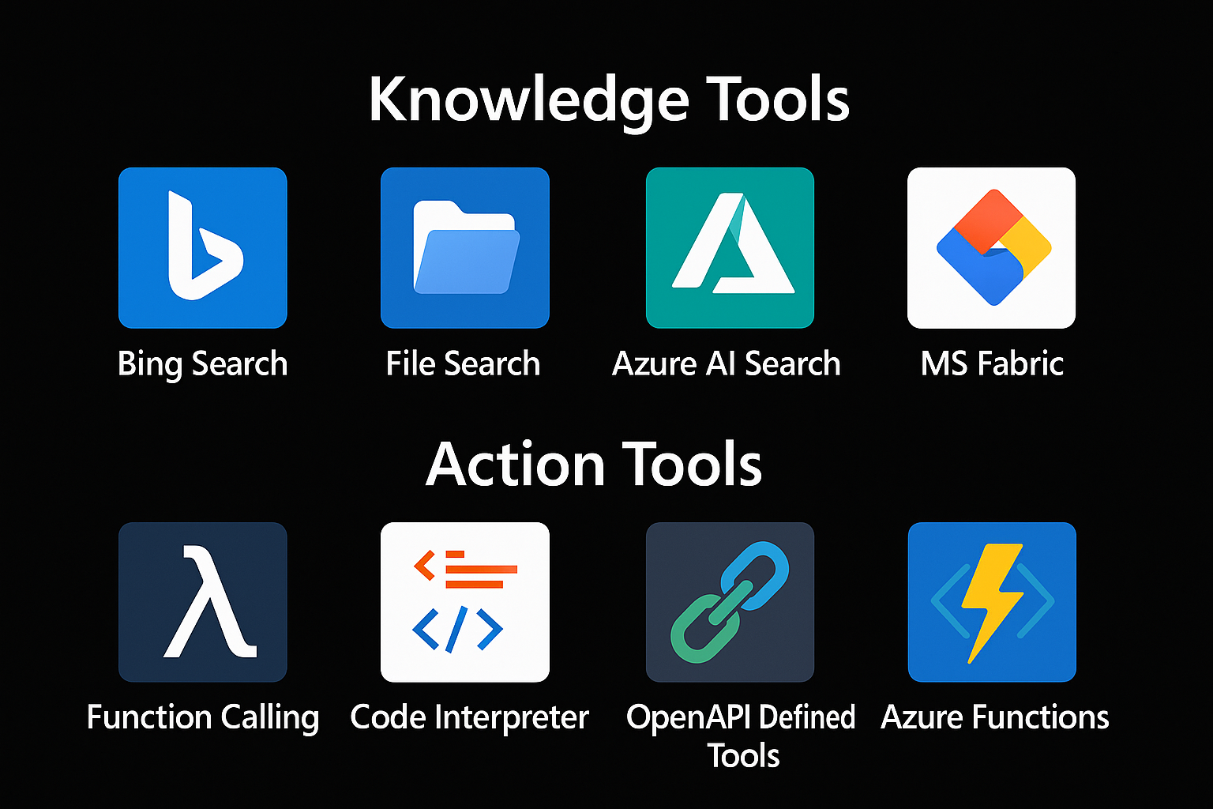

Extending Models
=> RAG
Tool 1
AGENT
=> Function Calling
Tool 2

Slide 33
RAG Retrieval Augmented Generation

Slide 34
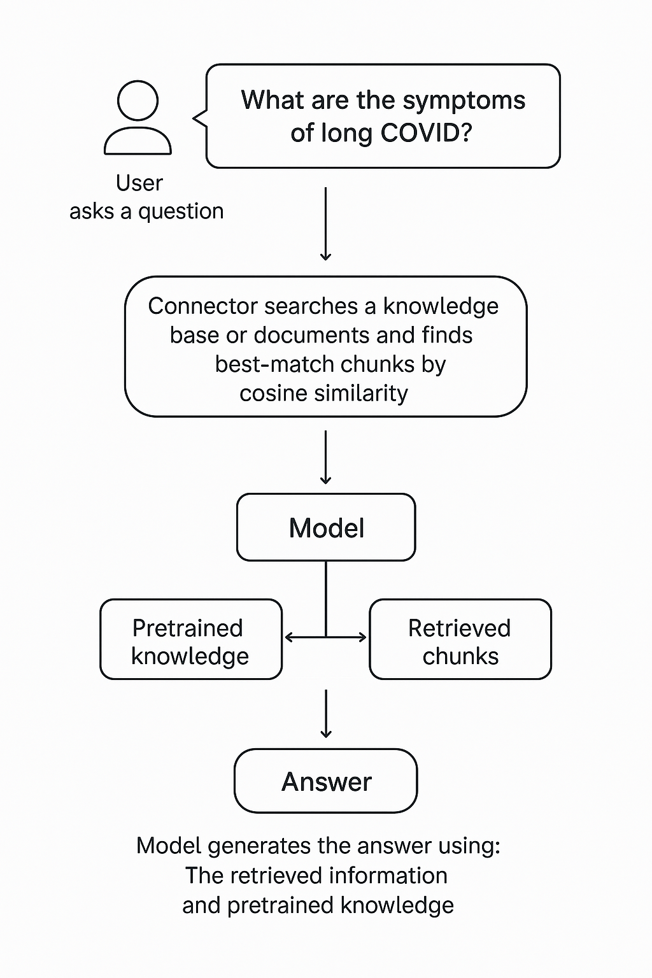
RAG Retrieval-Augmented Generation
Extending the model knowledge
Combines information retrieval with text generation
https://arxiv.org/abs/2005.11401

Slide 35
DEMO (c#)
Creating chunks
Creating embeddings
InMemory Vector DB
Calculating Similarity

Slide 36
Function Calling

Slide 37



Chat Model Interaction
User: How are you?
(1)
AI
Prompt
(2)
Assistent: I‘m fine, ho wcan I help you

Slide 38

Function Calling
Schritt 2:
KI ermittelt aus dem Prompt die passende Funktion und Argumente. Bsp.:
SchallteLichAn(grün)
Plugin Library
Enthält die Beschreibungen von Funktionen.
User: Switch on the light to green.
LichtPlugin
SwitchLightOn(color)
SwitychLightOff
(1)
WeatherPlugin
ShowInfo(Location)
AI
Prompt
(2)
My Database
Tool: SwitchLightOn(green)

Slide 39
Function Calling
{
"type": "function",
"function": {
"name": "get_weather",
"description": "Retrieves current weather for the given location.",
"strict": true,
"parameters": {
"type": "object",
"properties": {
"location": {
"type": "string",
"description": "City and country e.g. Bogotá, Colombia"
},
"units": {
"type": ["string", "null"],
"enum": ["celsius", "fahrenheit"],
"description": "Units the temperature will be returned in."
}
},
"required": ["location", "units"],
"additionalProperties": false
}
}
}

Slide 40
Open AI Assistent vs. Azure Agent?
Both services enable you to build agents using the same API and SDKs.
Azure offers additional enterprise requirements as Azure AI Agent Service.
Flexible model selection Many Azure OpenAI models, or others such as Llama 3, Mistral and Cohere.
Extensive data integrations Grounding with secure enterprise knowledge from various data sources, such as Microsoft Bing, Azure AI Search, and other (your) APIs.
Enterprise grade security Ensure data privacy and compliance.

Slide 41
PROCESS FRAMEWORK
semantic-kernel/dotnet/samples/GettingStartedWithProcesses
Process Framework | Microsoft Learn

Slide 42
Process Framework
Tool 1
AGENT
Tool 2
Tool N

Slide 44
Microsoft confidential
Pause: 10.30-11.00
https://github.com/ddobric/semantic-kernel-training/settings/access

